Slide 1
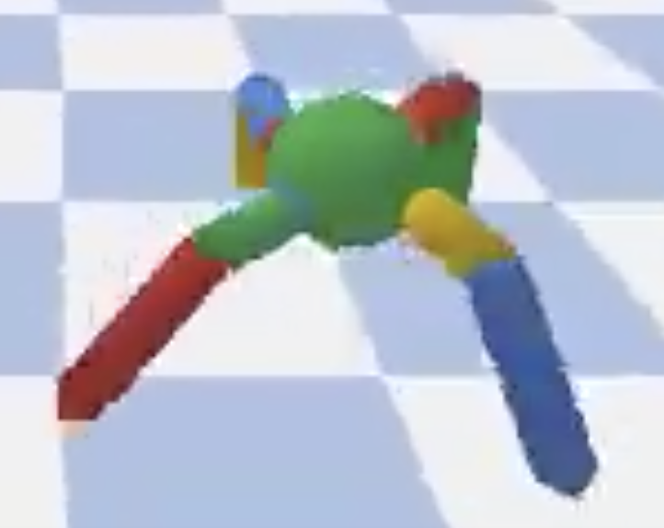
TWIN DELAYED DDPG (T3D)

Slide 2









Step1: Define Experience Replay Memory
ADD
Get Random Sample
SAMPLE
Batch Size

Slide 3
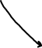
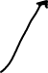
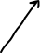
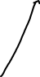
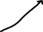
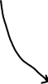
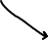
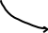
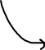
Step2: Define Actor Model
States
(state_dims)
Actions
(action_dim)
400
300
Input
Layer1
Layer2
Layer3
Output (Q Values)

Slide 4
Step3: Define Critic Model
First Critic Network
Q Value
(action_dim)
Input
States
(state_dims)
400
300
Layer1
Layer2
Layer3
Output Max(Q) Value
Input
Q Value
(action_dim)
Actions
(action_dims)
400
300
Layer6
Output Max(Q) Value
Layer4
Layer5
Second Critic Network

Slide 5
T3D MODEL ARCHITECTURE
First Critic Network
Q Value
(action_dim)
Input
States
(state_dims)
Actions
(action_dim)
States
(state_dims)
400
300
Layer1
Layer2
Layer3
Output Max(Q) Value
400
300
Input
Input
Layer1
Layer2
Layer3
Output (Q Values)
Q Value
(action_dim)
Actions
(action_dims)
400
300
Layer6
Output Max(Q) Value
Layer4
Layer5
Actor Model
Critic Model
Second Critic Network
First Critic Network
Q Value
(action_dim)
Input
States
(state_dims)
States
(state_dims)
400
300
Actions
(action_dim)
Layer1
Layer2
Layer3
Output Max(Q) Value
400
Input
Layer1
300
Layer3
Output (Q Values)
Q Value
(action_dim)
Input
Layer2
Actions
(action_dims)
400
300
Layer6
Output Max(Q) Value
Actor Target
Layer4
Layer5
Critic Target
Second Critic Network

Slide 6
Step4: Get Random sample from Experience Replay Memory
Replay Memory
Last States (s) | Next States (s’) | Actions (a) | Rewards (r)
Last State 1 | Next State 1 | Action 1 | Reward 1
Last State 2 | Next State 2 | Action 2 | Reward 2
… | … | … | …
Last State 100 | Next State 100 | Action 100 | Reward 100
Get Random Sample
Send to Device (CPU/GPU)

Slide 7


Step5: Get Next Action (a’) from Next State(s’) using actor target
Next State(s’)
Next Action(a’)
400
300
Input
Layer1
Layer2
Layer3
Output (Q Values)
Actor Target

Slide 8



Step6: Gaussian Noise to Next Action (a’) and clamp to a range
Clamp action within environment range
Next Action(a’)
Next Action with Gaussian Noise
Modified Next Action(a’)

Slide 9
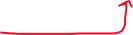


Step7: Two Critic Target take s’ and a’ as input and return two Q Values
First Critic Network
Q Value
(action_dim)
Input
Input s’ and a’
States
(state_dims)
400
300
Output Q1 and Q2
Layer1
Layer2
Layer3
Output Max(Q) Value
Input
Q Value
(action_dim)
Actions
(action_dims)
400
300
Layer6
Output Max(Q) Value
Layer4
Layer5
Second Critic Network
Two Critic Target

Slide 10


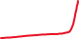
Step8:Take Minimum of Q1 and Q2 and output Target Q
Q1
Target Q
Take Minimum
Q2

Slide 11
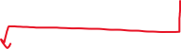
Step9: Get the final target of the two Critic models
target_Q = reward + ((1-done) * discount * target_Q).detach()
Done=1 (episode over) Done=0 (episode not over)

Slide 12
Step10: Two Critic Model take current state(s) and current action (a) as input
and return two current Q Values
First Critic Network
Q Value
(action_dim)
Input
Input s and a
States
(state_dims)
400
300
Output Current Q1 and Q2
Layer1
Layer2
Layer3
Output Max(Q) Value
Input
Q Value
(action_dim)
Actions
(action_dims)
400
300
Layer6
Output Max(Q) Value
Layer4
Layer5
Second Critic Network
Two Critic Model

Slide 13




Step11: Compute the Critic Loss
Current Q1
MSE Loss
Critic Loss
Target Q
MSE Loss
Current Q2

Slide 14
Step12: Backpropagate the critic loss and update the parameters of two Critic models
initializing gradients to zero
First Critic Network
Q Value
(action_dim)
Perform Weight Updates using Adam optimizer
Input
States
(state_dims)
400
300
Layer1
Layer2
Layer3
Output Max(Q) Value
Backpropagate Critic Loss
Input
Q Value
(action_dim)
Actions
(action_dims)
400
300
Layer6
Output Max(Q) Value
Layer4
Layer5
Second Critic Network
Two Critic models

Slide 15
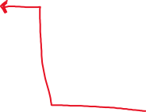
Step13: Once every two iterations, we update our Actor model
initializing gradients to zero
First Critic Network
Backpropagate Actor Loss
Q Value
(action_dim)
initializing gradients to zero
Input
States
(state_dims)
400
300
Step13: Once every two iteration of critic model update
Perform Weight Updates using Adam optimizer
Layer1
Layer2
Layer3
Output Max(Q) Value
Backpropagate Critic Loss
Input
Q Value
(action_dim)
States
(state_dims)
Actions
(action_dim)
Actions
(action_dims)
Actor Model
400
300
Layer4
Layer5
Layer6
Output Max(Q) Value
400
Second Critic Network
Layer1
300
Layer3
Output (Q Values)
Two Critic models
Input
Layer2
Perform Weight Updates using Adam optimizer

Slide 16
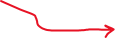
Step14: Still, in once every two iterations, update our Actor Target by Polyak Averaging
initializing gradients to zero
First Critic Network
Backpropagate Actor Loss
Q Value
(action_dim)
initializing gradients to zero
Input
States
(state_dims)
400
300
Perform Weight Updates using Adam optimizer
Layer1
Layer2
Layer3
Output Max(Q) Value
Backpropagate Critic Loss
Once every two iteration of critic model update
Input
Q Value
(action_dim)
Actions
(action_dims)
States
(state_dims)
Actions
(action_dim)
Actor Model
400
300
Layer6
Output Max(Q) Value
Layer4
Layer5
Second Critic Network
400
300
Two Critic models
Input
Layer1
Layer2
Layer3
Output (Q Values)
States
(state_dims)
Actions
(action_dim)
Actor Target
Perform Weight Updates using Adam optimizer
400
300
Layer3
Output (Q Values)
Input
Layer1
Layer2
Step 14:Update Actor Target using Polyak Averaging

Slide 17
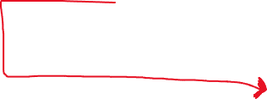
Step15: Still, in once every two iterations, we update our Critic Target by Polyak Averaging
initializing gradients to zero
First Critic Network
Backpropagate Actor Loss
Q Value
(action_dim)
initializing gradients to zero
Input
States
(state_dims)
400
300
Once every two iteration of critic model update
Perform Weight Updates using Adam optimizer
Layer1
Layer2
Layer3
Output Max(Q) Value
Backpropagate Critic Loss
Input
Q Value
(action_dim)
Actions
(action_dims)
Step15: Once every two iteration of critic model update
States
(state_dims)
Actions
(action_dim)
400
300
Layer6
Output Max(Q) Value
Layer4
Layer5
Actor Model
Second Critic Network
Two Critic models
400
300
Layer3
Output (Q Values)
Input
Layer1
Layer2
First Critic Network
Update Critic Target using Polyak Averaging
Q Value
(action_dim)
States
(state_dims)
Actions
(action_dim)
Actor Target
Input
States
(state_dims)
400
300
Layer1
Layer2
Layer3
Output Max(Q) Value
Perform Weight Updates using Adam optimizer
400
300
Layer3
Output (Q Values)
Input
Layer1
Layer2
Update Actor Target using Polyak Averaging
Input
Q Value
(action_dim)
Actions
(action_dims)
400
300
Layer6
Output Max(Q) Value
Two Critic Targets
Layer4
Layer5
Second Critic Network

